Slide 1
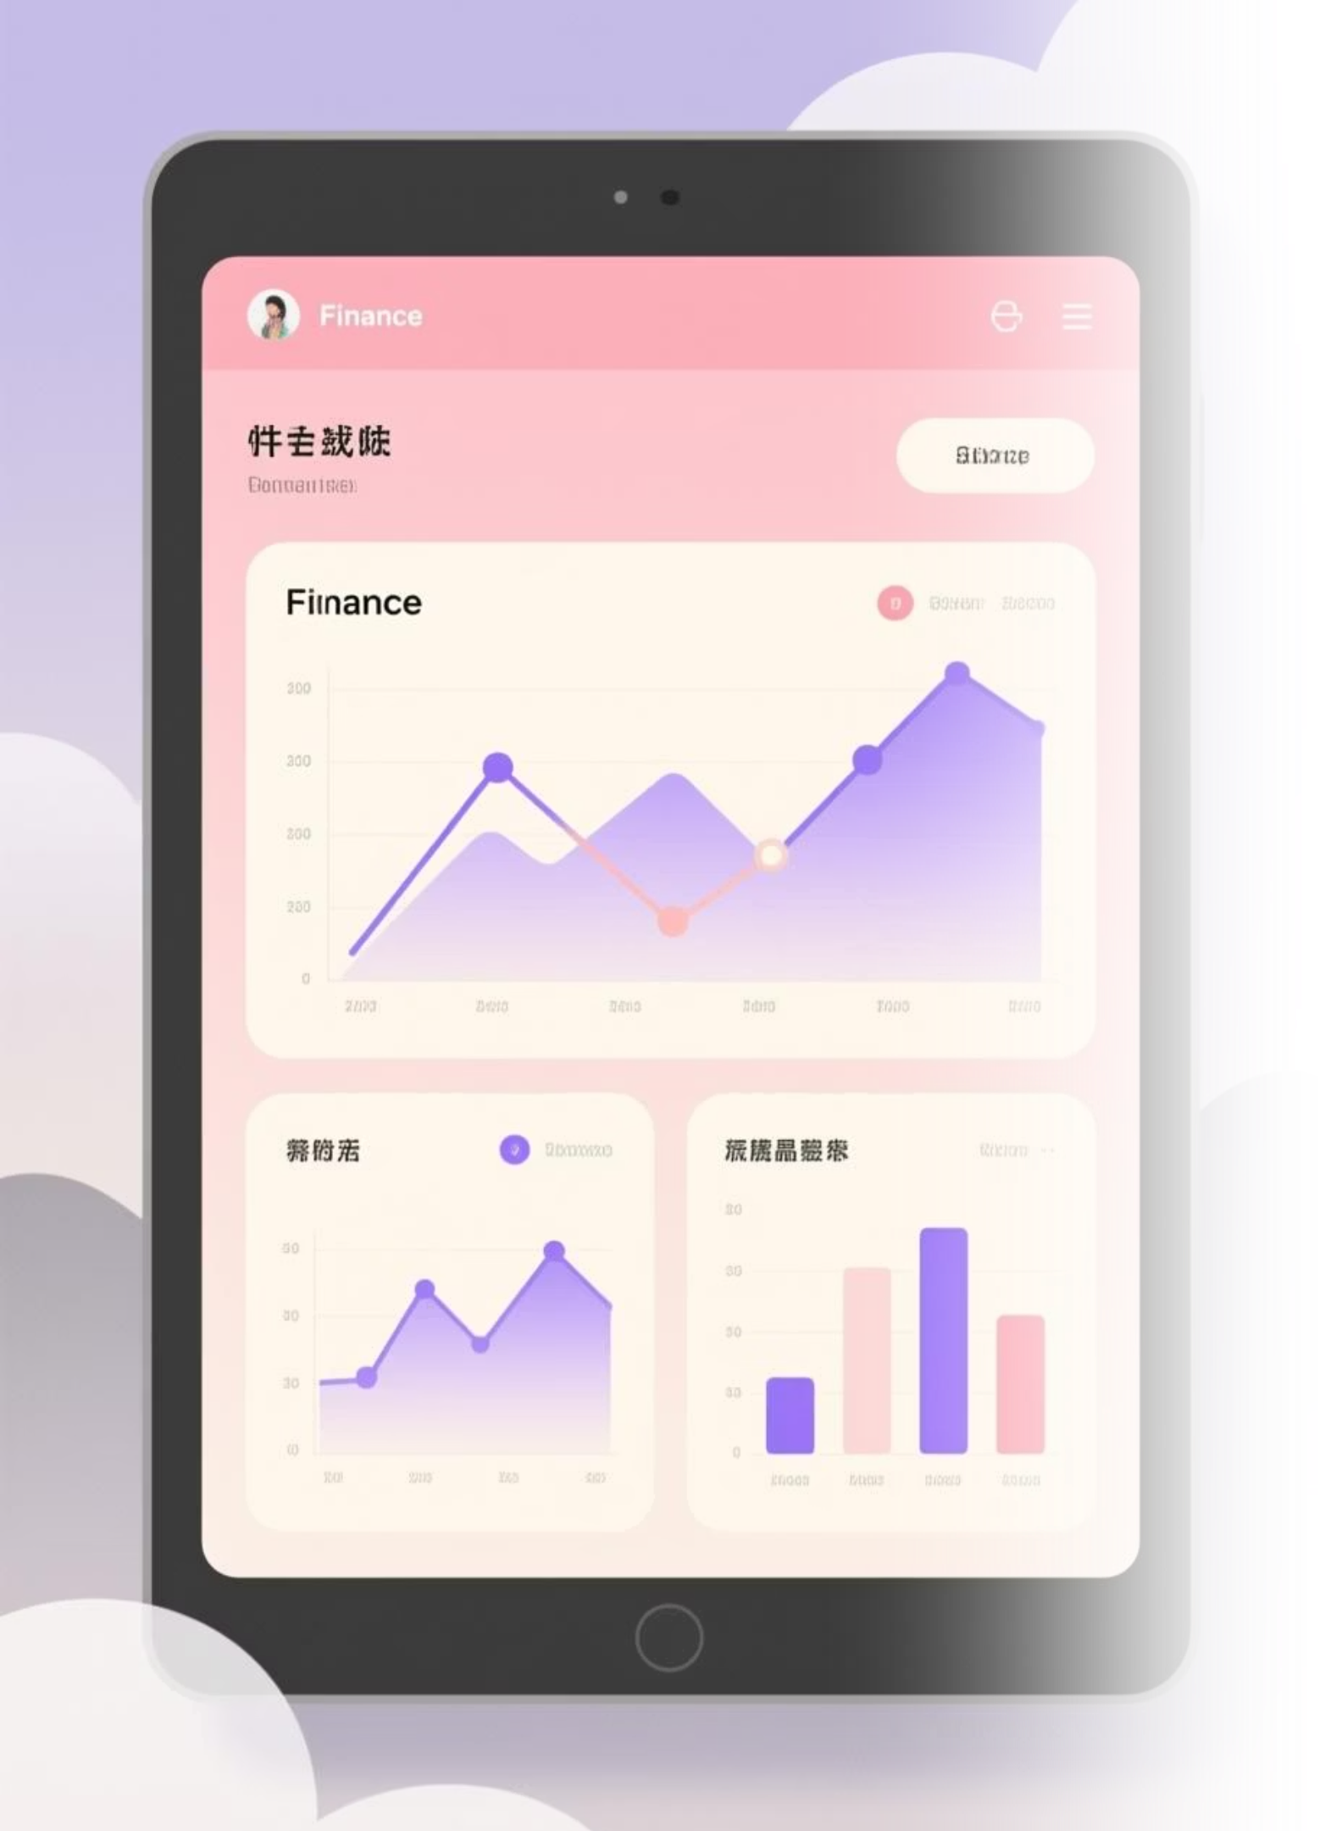
FinanceFlow
Your intelligent personal finance companion

Slide 2

The Challenge Today
Money Management Feels Complex
Critical Needs Go Unmet
Predictive insights, intelligent recommendations, and automated reminders could transform how we manage our finances—but they're rarely available in one place.
Most people struggle to track expenses, understand their financial situation, and make informed decisions without spending hours on spreadsheets.

Slide 3

Introducing AI-Powered Financial Intelligence
We're building a smarter way to manage money. Our upcoming AI features will predict your financial needs, recommend optimal borrowing amounts, and keep you on top of recurring expenses—all automatically.

Slide 4
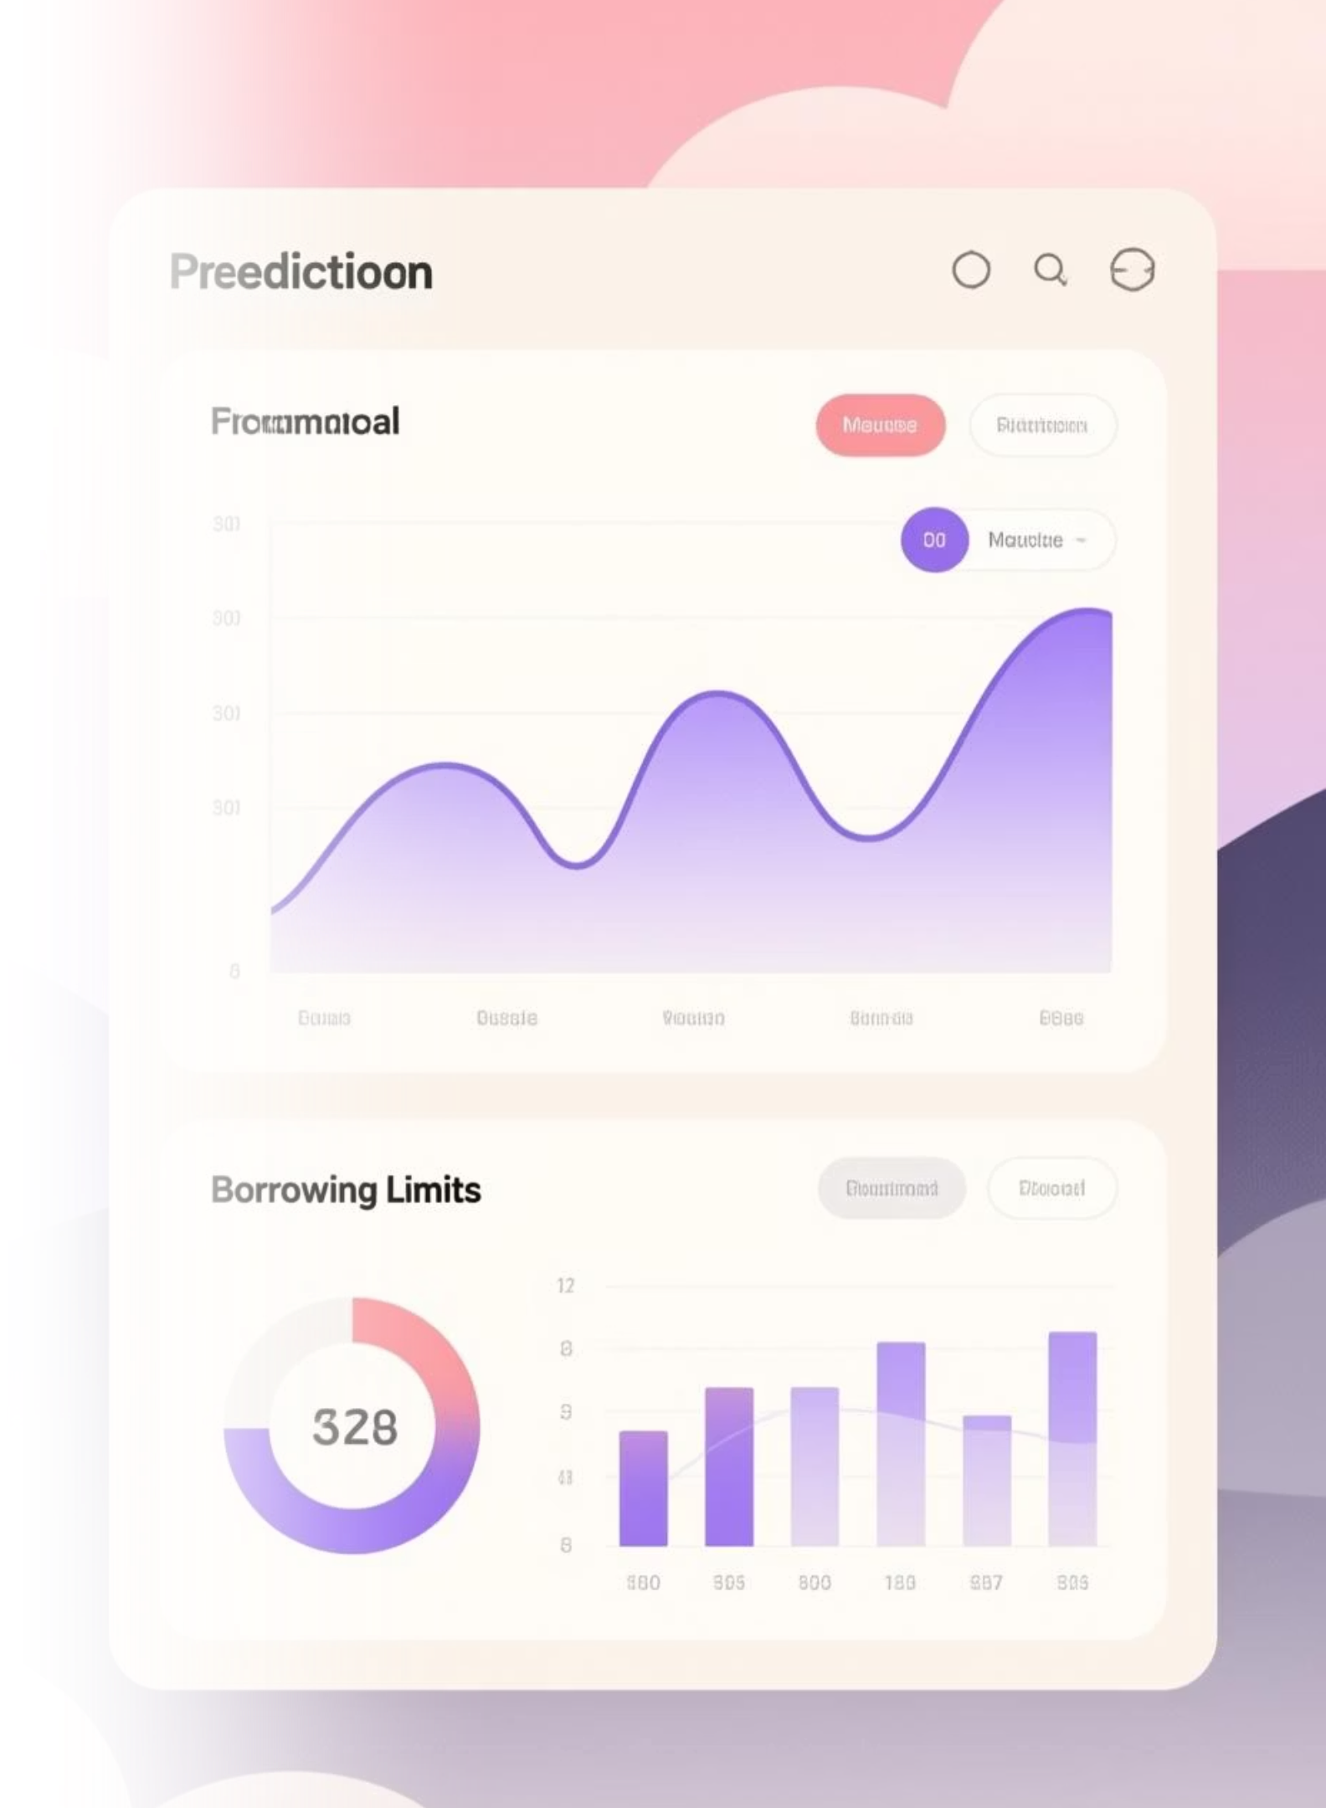
Predictive Borrowing Intelligence
Detect Financial Gaps
Smart Loan Recommendations
Our AI monitors your cash flow patterns and identifies when you're approaching a shortage before it becomes a problem. But not pays automatically. This only tracks the transaction of money but not transfers.
When funding is needed, the system recommends precise loan amounts based on your spending patterns and repayment capacity.( curently unavailable)
Timing Optimisation
Receive guidance on the ideal timing for borrowing to minimise interest costs and maximise your financial stability.

Slide 5



Automated Recurring Bill Reminders
Never miss an important payment again. Our intelligent reminder system tracks recurring expenses and keeps you informed.
Electricity Bills
Insurance Premiums
Subscriptions & Services
Automatic reminders ensure your essential utilities stay connected without late fees or service interruptions.
Stay protected withtimely notifications for health, home, and vehicle insurance renewals and payments.
Keep track of newspaper subscriptions, memberships, and other recurring services you've forgotten about.

Slide 6




How AI Transforms Your Financial Life
Real-Time Insights
Understand your financial position instantly, with AI-generated summaries of your spending patterns and trends.
Proactive Guidance
Receive recommendations before problems occur—never be caught off guard by unexpected shortages.
Complete Peace of Mind
Automated reminders for all recurring bills mean you can focus on life while your finances run smoothly.

Slide 7
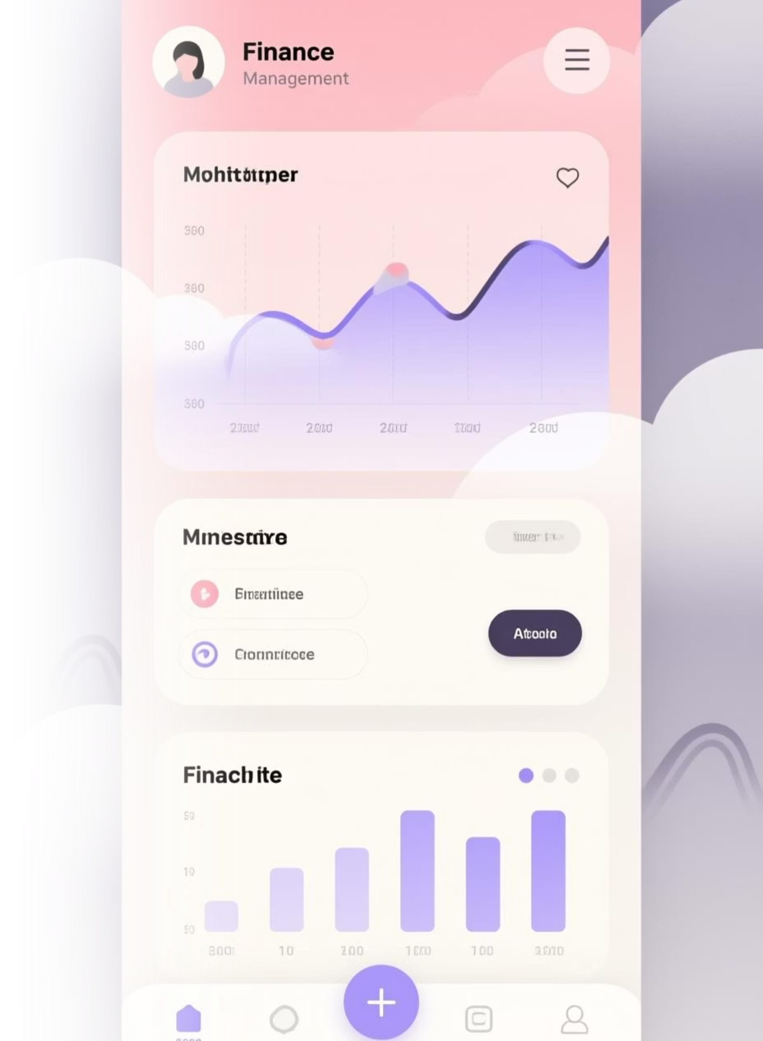
The Complete AI Feature Set
Expense Tracking
Predictive Analysis
Smart Borrowing
Automated Reminders
A unified platform that brings together everything you need for intelligent financial management.

Slide 8

Who Benefits Most
Small Business Owners
Everyday Users
Track business expenses, manage cash flow, and receive AI-powered insights for better financial decisions.
Simplify personal finance with automated reminders and intelligent recommendations that fit your life.

Slide 9

The Future of Personal Finance
Simple. Intelligent. Secure.
Our AI-powered financial platform combines cutting-edge technology with user-friendly design. Whether you're managing household budgets or growing a small business, FinanceFlow learns your patterns and works proactively to keep your finances healthy.

Slide 10

Ready to Take Control?
Experience the future of personal and business finance management with intelligent predictions, smart recommendations, and automated peace of mind.
Predict Shortages
Optimise Borrowing
Before they happen
With confidence
Never Miss Bills
Stay on track

